Slide 1

Day 3:
Simple BMI
Introduction
Notes:
Photo by Csaba Balazs on Unsplash

Slide 2

Your 6-Day Success Plan
You have done this!
Day 0 (30 mins):
Roadmap to Software Dev
Learn the pros of being software dev
Learn the step by step to be software dev

Slide 3
Your 6-Day Success Plan
You also have done this!
Day 1 (1h):
Learn creating a website using HTML
Create Your First Website
Understand how websites understand HTML
Use HTML to create links & texts
Build a resume website

Slide 4
Your 6-Day Success Plan
You also have done done this!
Day 2 (1h):
Learn to style a website using CSS
Styling Websites
Add your profile picture for employers!
Learn to create buttons and design them
Build a Link in Bio project

Slide 5

Your 6-Day Success Plan
We are currently here
Day 3 (1h):
Learn data types such as numbers & strings
Build Interactive Website
Understand how to store data in variables
Learn how to show data
Create BMI calculator

Slide 6
Your 6-Day Success Plan
Day 4 (1h):
Learn to get user inputs
Better BMI
Understand how to make website interactive
Create better BMI calculator

Slide 7
Your 6-Day Success Plan
Day 5 (1h):
Learn how to create a list of quotes
Random Quote Generator
Show the quotes randomly
Create random quote generator

Slide 8
Your 6-Day Success Plan
Day 6 (1h):
Learn how to know if answer is correct
Quiz App
Show if the user got it right or not
Create quiz app

Slide 9
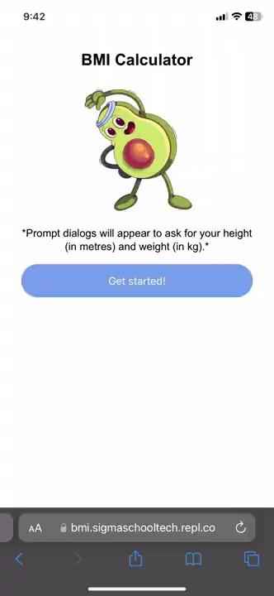
What you are building
A bmi calculator that prompts user to key in their weight and height, and return their BMI!
What you are learning:
- Learn data types such as text and numbers
- Understand how to store data in variables
- Understand functions basics
- Create BMI calculator
Demo project here.

Slide 10
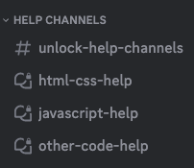
Need help?
We are happy to help with any issues, things you don’t understand in our Discord channel here.
Here is our full link:
https://discord.gg/yCrB7tfbhg
Once in discord, add your questions in our help channels.

Slide 11
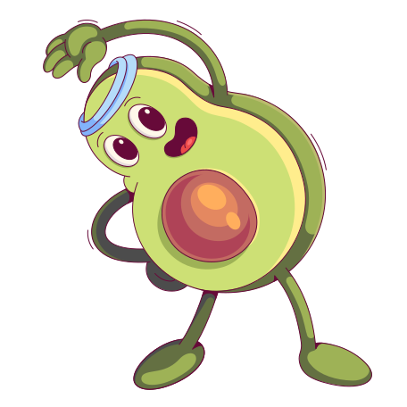
Download this image
Interesting story about this image…
… it's that there’s no interesting story.
I am not typing this text just to make fill up the words here.
Okay. Maybe.
Anyway, here is the link:
https://drive.google.com/file/d/1G9YB18xW1qv5eq4eUTPK7xVUfmjU3VTh/view?usp=sharing

Slide 12
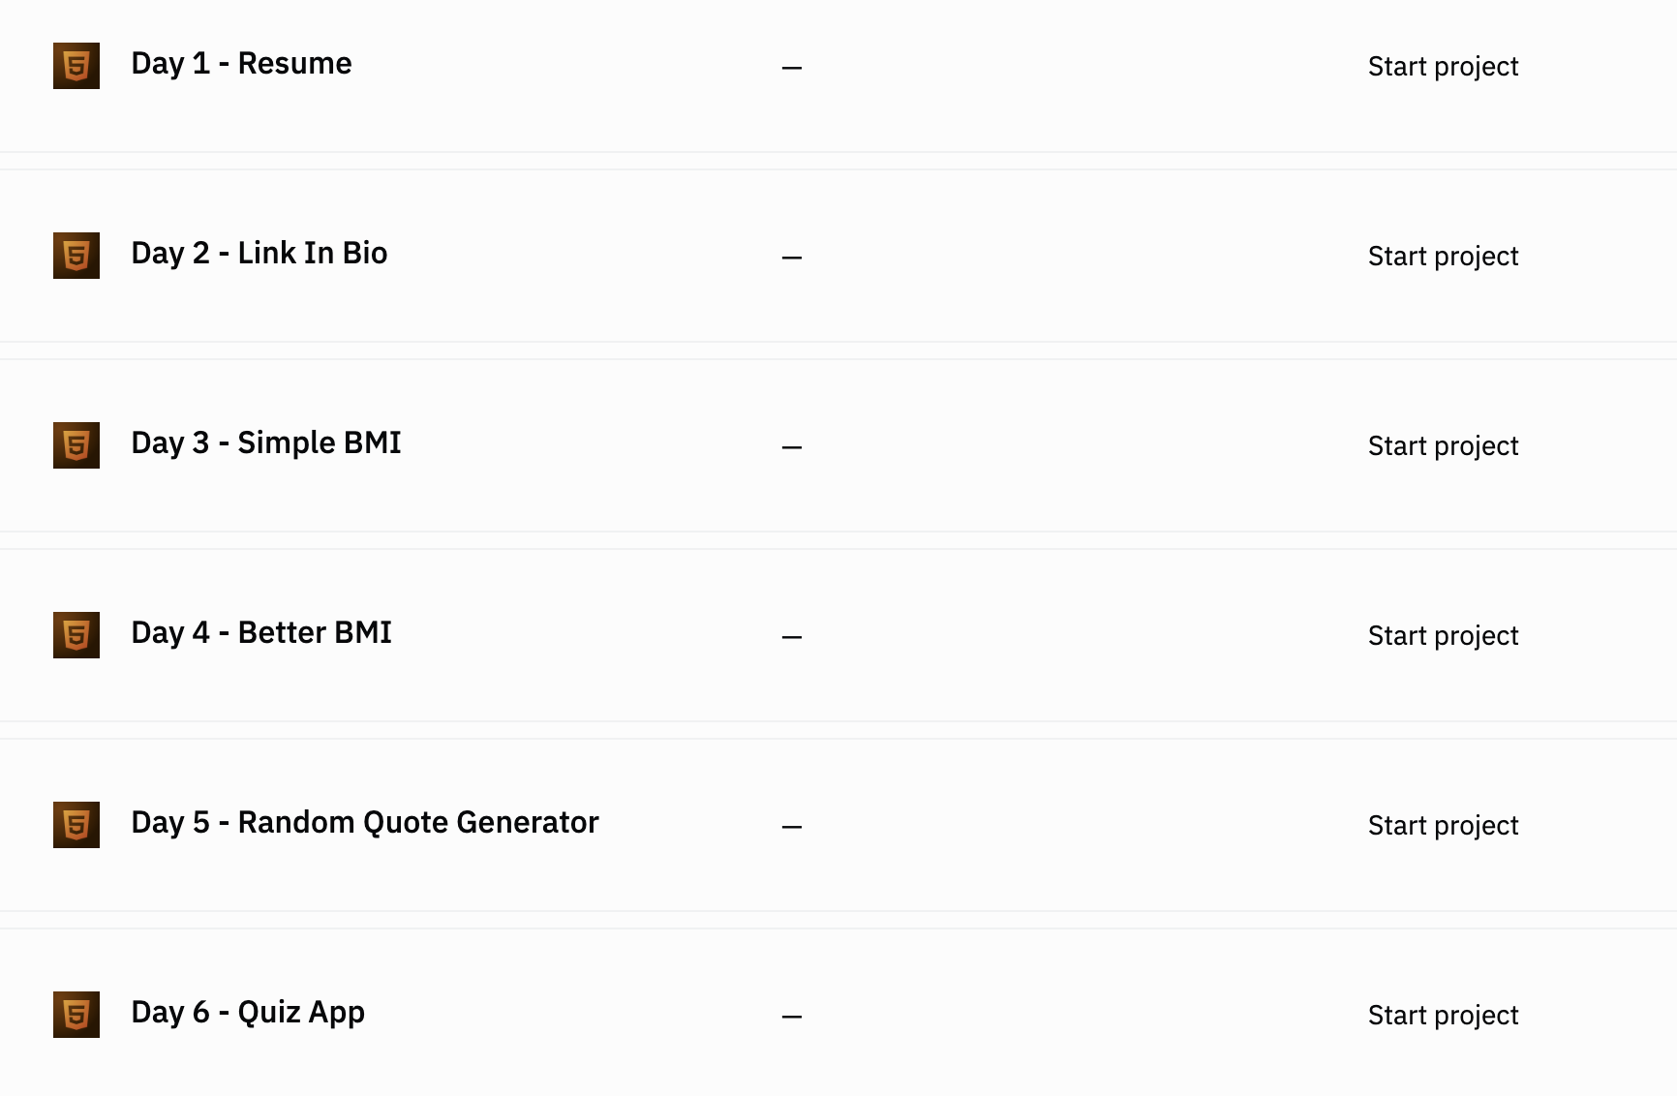

Go to our team dashboard: https://sig1.co/replit-6in6
You can click on Day 3 - Simple BMI:

Slide 13
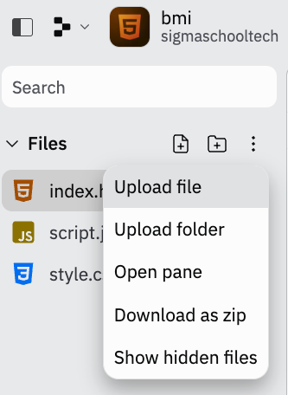
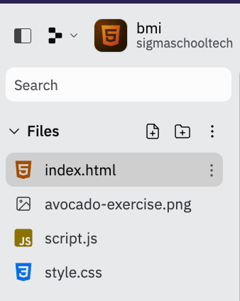
Upload the image to the project and it should look like this.
1
2
3

Slide 14
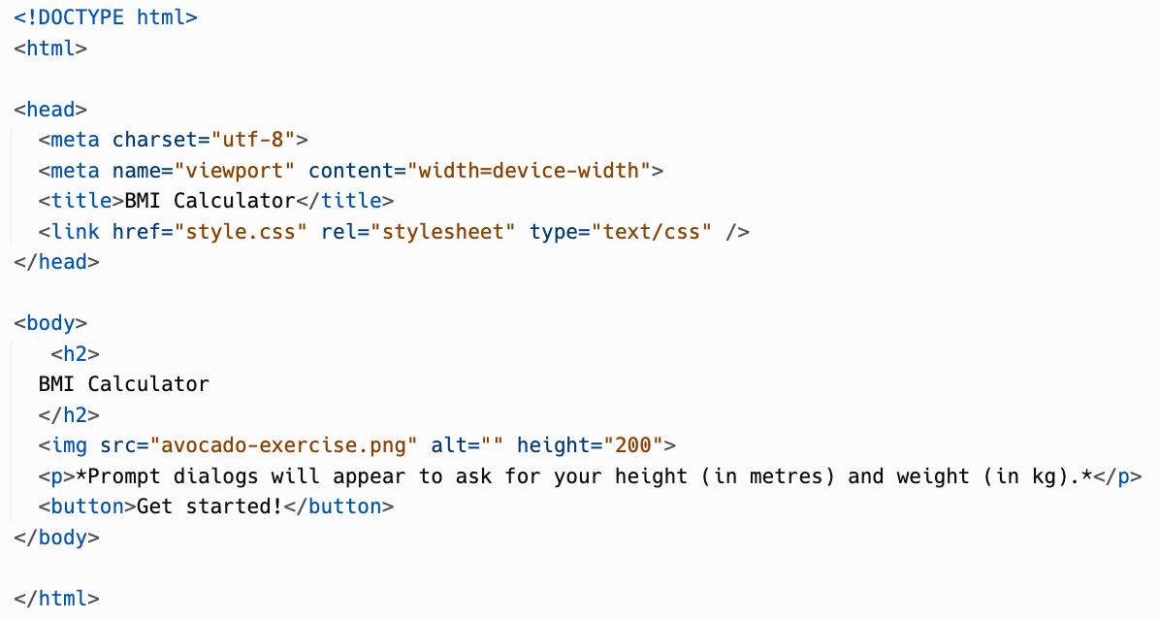
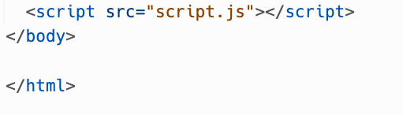
In the index.html, update the code to this

Slide 15
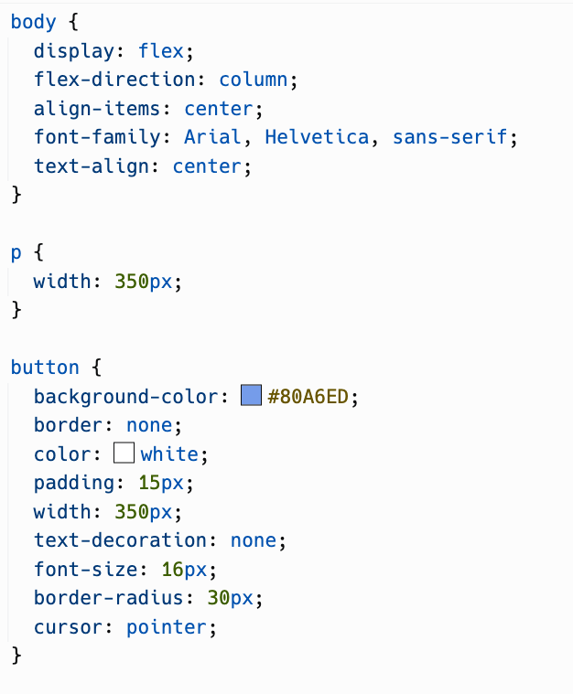
In the style.css, update the code to this.

Slide 16
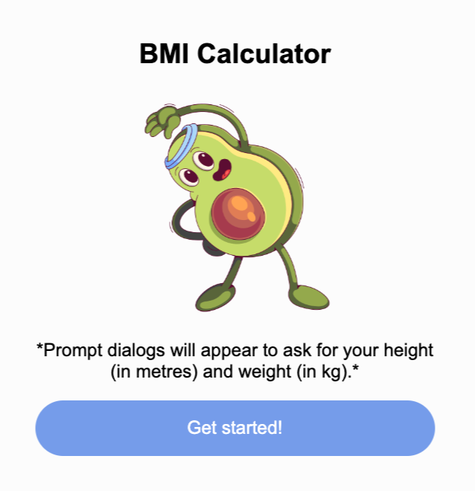
Run the code, and it should like this. Let’s explain on what you have added!

Slide 17
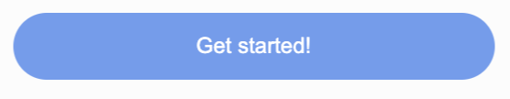

In the style.css
Most of the code are similar to Day 2.
However, there is one new addition
cursor: pointer;
When creating a new button using <button>, it does not change the cursor when hovering over it.
Therefore, we set the property cursor to the pointer cursor, which we are used to.
Default: cursor don’t change
cursor: pointer;

Slide 18
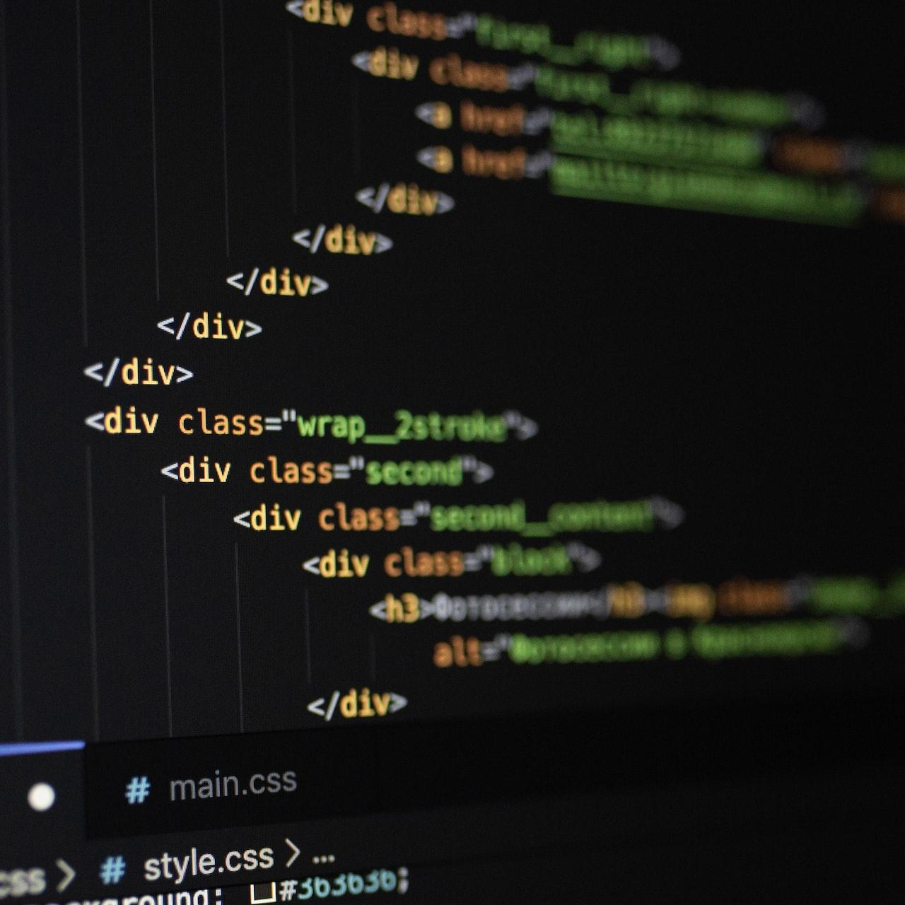
Explanation for index.html
Most of the code you have added have been explained before. Refer to Day 1 & 2 slides to have a refresher.
However, there is 2 new things we added:
<button> tag
<script> tag

Slide 19

<button>
Used to create a clickable button to trigger functions (which we will go through later).
What is the difference between <a> and <button> tag?
<a> is to create links that goes to a website, and we can style them as button. <button> is to create buttons that we can use Javascript (JS) code with.
Since we are talking about JS…
Notes:
Photo by Mourizal Zativa on Unsplash

Slide 20
<script>
It is a way to connect a JS file to the HTML website. The src attribute is to get the location of the file you want to connect.
Why is it called script.js? It’s just another convention (standard) for naming a file.
Why do I need a js file? This is where we can store the logic of the website. In this case, we are able to store the BMI calculation logic in the JS file.
Let’s explore on what JavaScript can do!

Slide 21
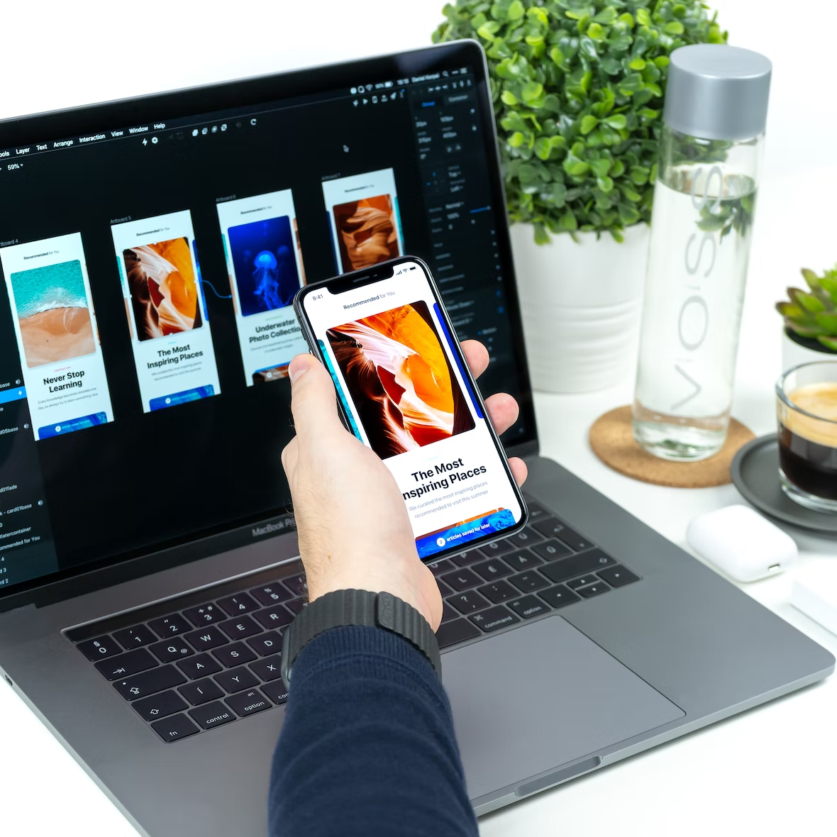
What is JavaScript?
Notes:
Image from: Unsplash

Slide 22
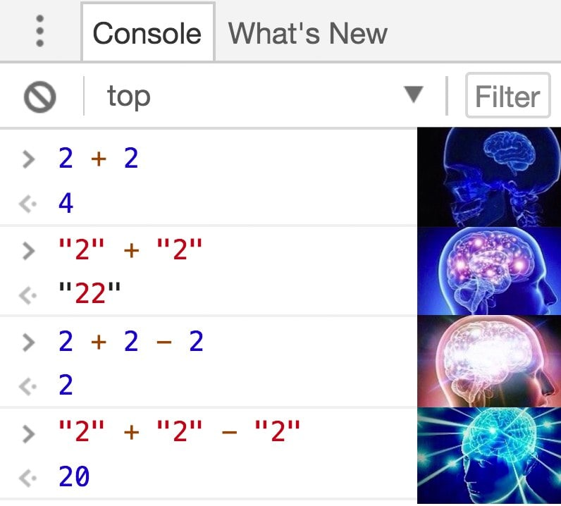
JavaScript (JS)
Was created in 1955.
First version was built in 10 days.
JS is most famous for being… quirky. Refer to meme on right.
Most popular web language, because it's the ONLY language that can run on the web browser.
Not only you can build websites with JS…

Slide 23
JavaScript can build
Web Application - HTML/CSS/JS
Mobile Application - React Native
Games - Phaser.io
Desktop Applications - Electron
Servers - Node.js
Operating System (like Mac, Windows) - Node OS
Data Analytics - D3JS
Animations - AnimeJS
Machine Learning - TensorFlowJS
Enough of what we can build, let’s learn the basics of Javascript.

Slide 24

JS Basics:
Variables
Notes:
Photo by Pierre Châtel-Innocenti on Unsplash

Slide 25
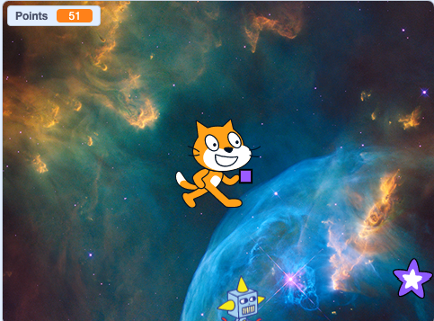
Have you played a game
And you are able to see how much points you scored?
How does the game store your score?
Well, the game store it in a variable.

Slide 26
Variable
Think of a variable as box, with a name, that stores a value.
For example, a variable named points, that stores the number 51.
In js, we type it as:
points = 51
What if we want to create a variable named age, which stores number 13?
points
51
Visualisation of variable

Slide 27
Variable
To create a variable named age, which stores number 13, in JS:
age = 13
Here are something to take note!
age
13
Visualisation of variable

Slide 28
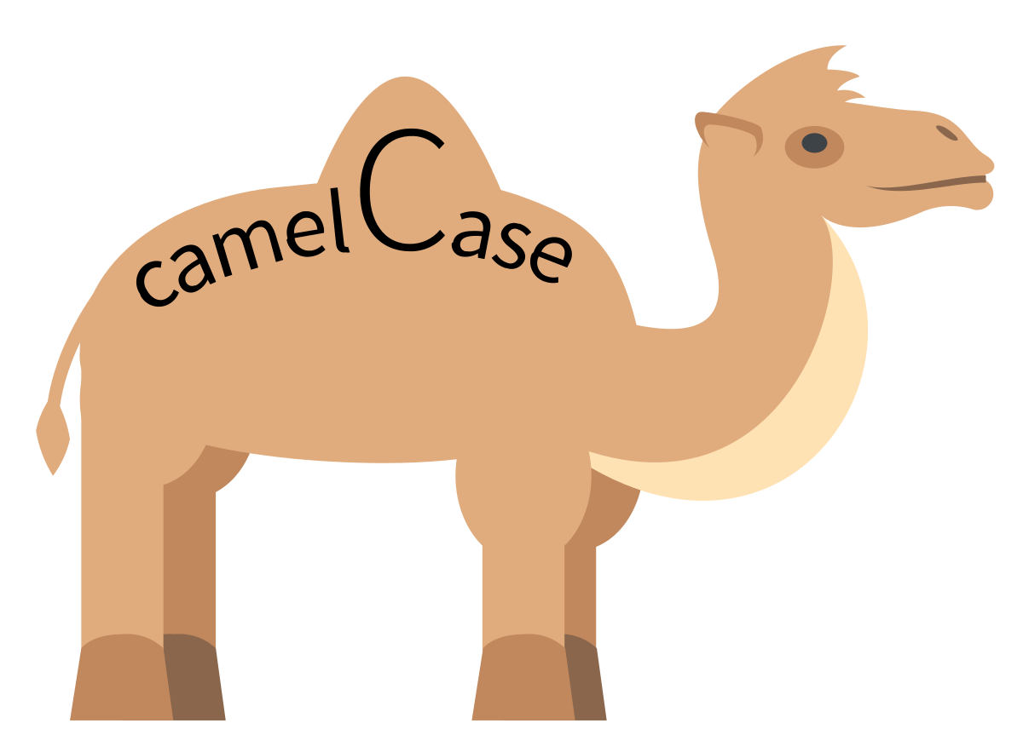
Variables should…
… be in camel case.
That means, the first word is in small case.
The second word should be in Title Case.
If you have a variable to describe previous year:
previousYear = 2022
Now let’s try to code it out in our project!

Slide 29
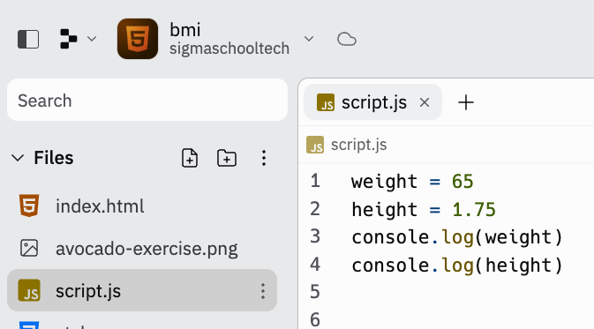
Go to script.js and add the code.

Slide 30
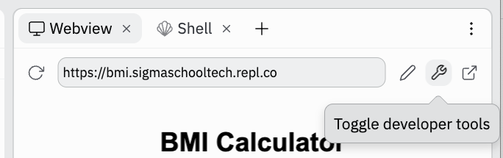
Let’s toggle the developer tools.

Slide 31
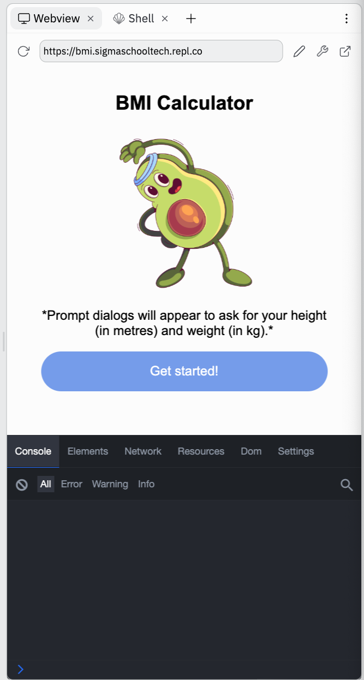
A black window would appear at the bottom of the website.
This the developer tools.
And by default, it will open up the console.

Slide 32
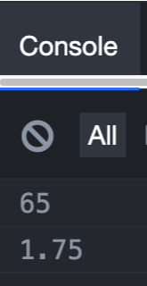
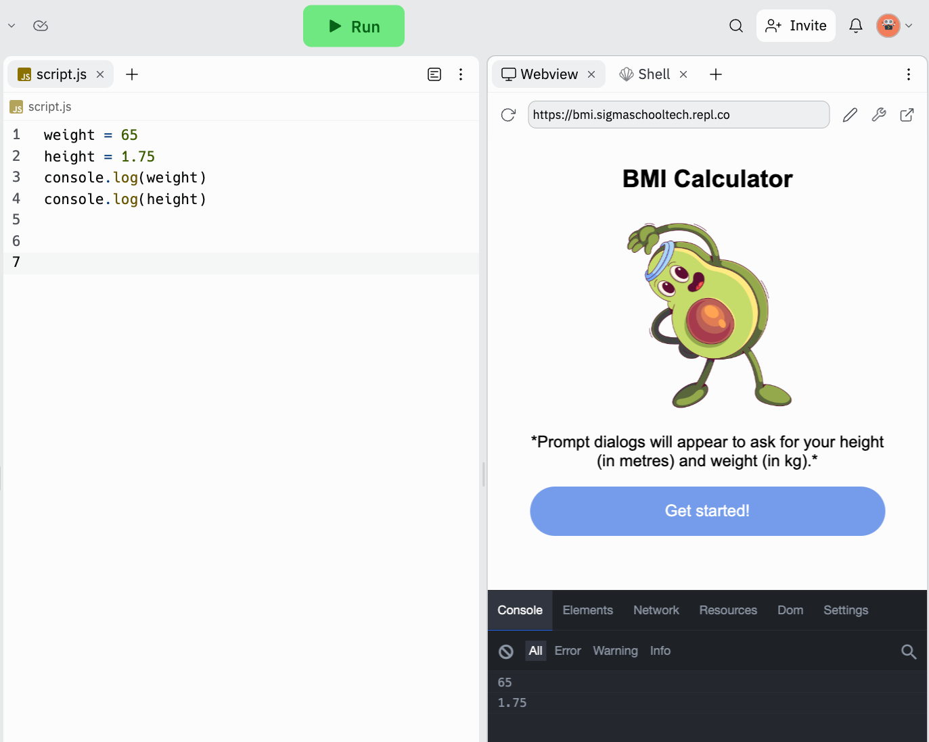
Run the code and the numbers should appear in the console. What happened?
1
2

Slide 33
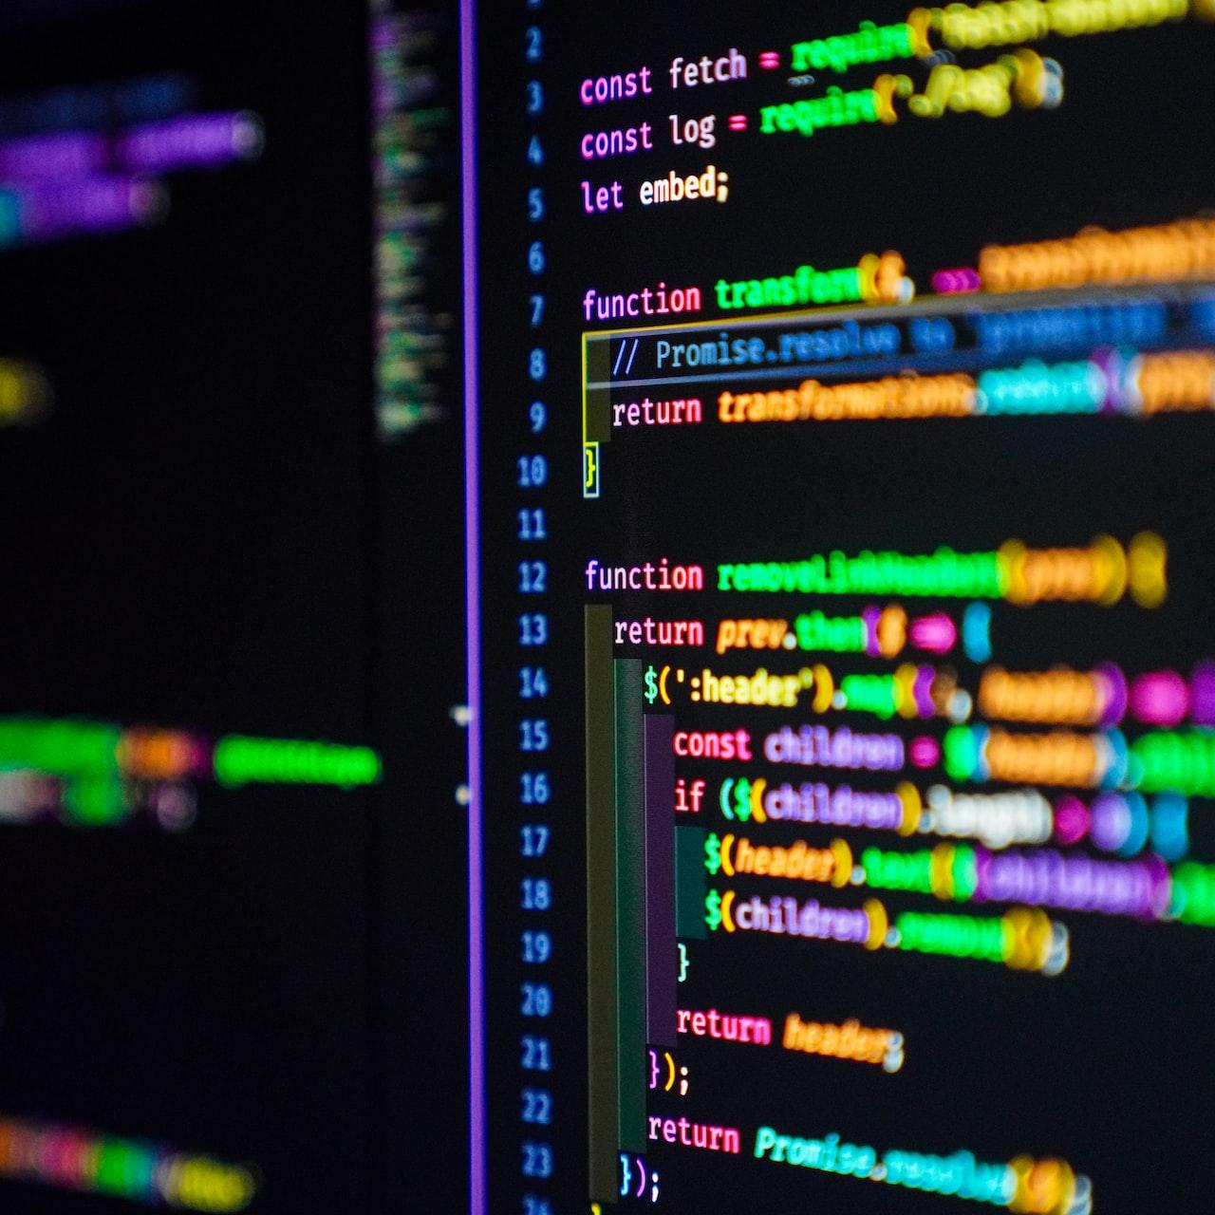
JS Basics:
console.log(),
Functions
Notes:
Photo by Joan Gamell on Unsplash

Slide 34
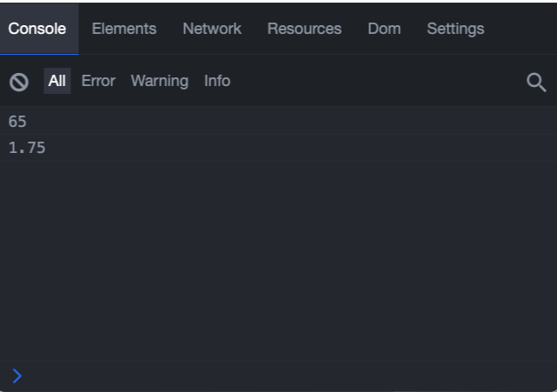
Console - Developer tools
When building a web project, we need to check for bugs and errors, how fast the webpage loads and many more.
To do these tasks, we need developer tools (dev tools for short).
The most common used tools is the console.

Slide 35
Console
It is a way to interact with code that we have written in our JS files (mainly).
Think of if as Replit code editor, but in every website.
Then what is console.log()?

Slide 36
Break down - console
.log
Think of console as a book.
And it has many instructions to it.
It has an instruction to log value in the console.
It has an instruction to show an error message in the console.
It has an instruction to show a warning in the console.
.error
console
.warn

Slide 37
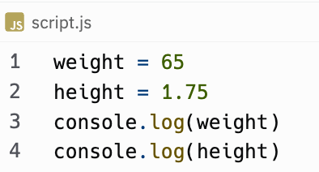
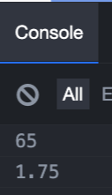
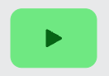
console.log() function
It is a function that allows us to log (or show) a value in the console.
What is a function?

Slide 38
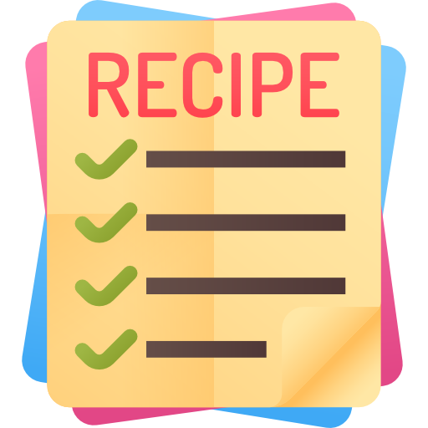

Functions
Functions are like a recipe.
It is a set of steps to do something.
In JS, they have created functions to do certain things.
For example, console.log() . There are other functions we are going to use!

Slide 39
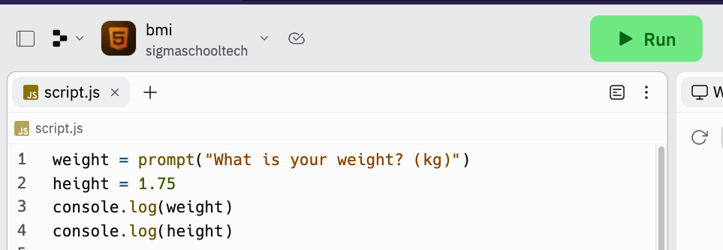
Update the code and run it!
2
1

Slide 40
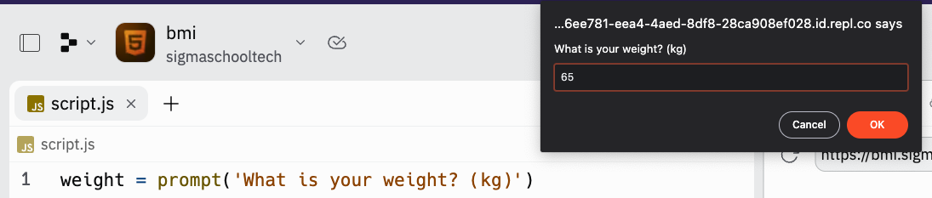
A prompt dialog should appear. Type in a weight and press OK!
1
2

Slide 41
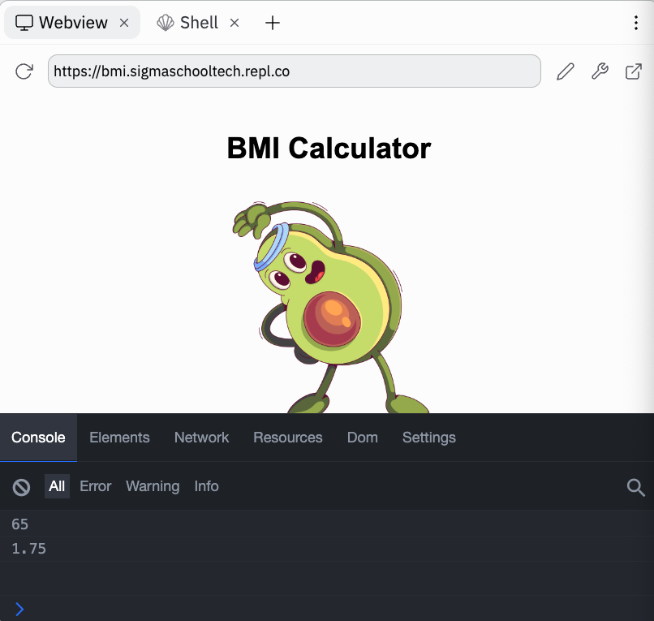
Toggle the developer tool, and you should see the console that prints your weight!
1
2

Slide 42
prompt()
This is also another function.
It will display a message, in this example,
“What is your weight? (kg)”
Why is there “inverted commas”?
Well, in JS, we represent text with inverted commas.

Slide 43
Strings
They are text in programming.
They can be assigned to a variable as well.
For example:
name = “Haris”
Let’s try it out in replit!

Slide 44
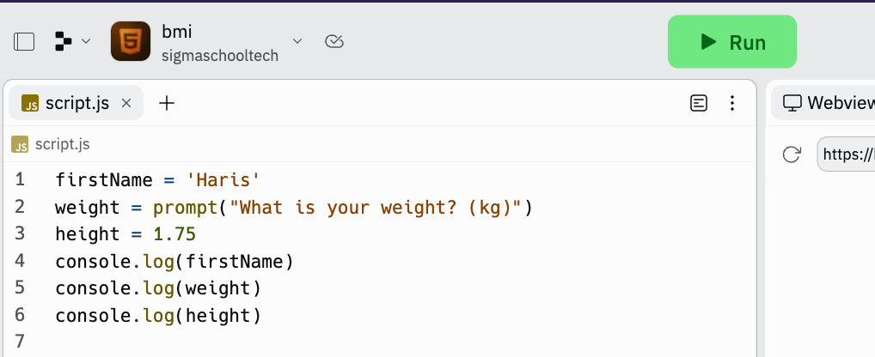
Update your code and run it!

Slide 45
A prompt dialog should appear. Type in a weight and press OK!
1
2

Slide 46
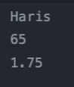
Toggle the developer tool, and you should see the console that prints your firstName!
1
2

Slide 47
Challenge
Make the these variables to have prompts with message (see weight variable):
firstName - What is your first name?
height - What is your height? (metres)
Once done, check answer on next slide!
message

Slide 48
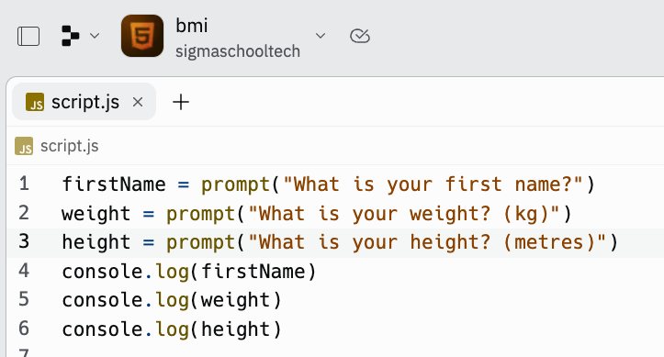
Answer. Let’s run this code

Slide 49
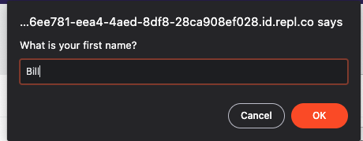
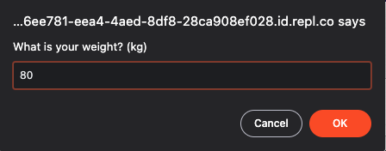
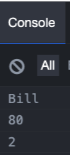
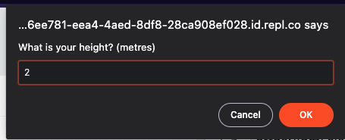
It should look like this. Now let’s calculate the bmi!

Slide 50
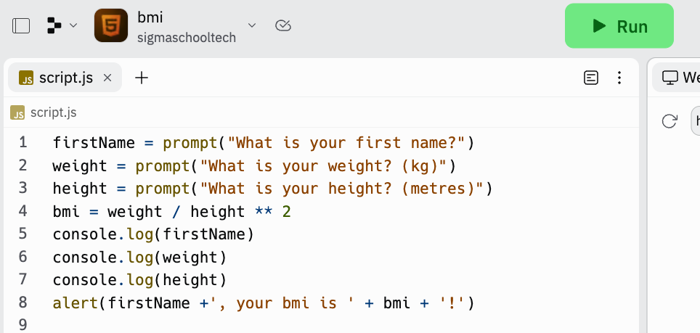
Update the code and run it!

Slide 51
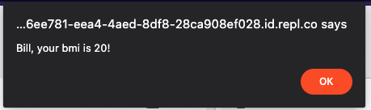
It should look like this. Let’s explore what happened!

Slide 52
Variables
You can use variables to use in math calculations.
For math, we have math operators:
Addition (+)
Subtraction (-)
Multiplication (*)
Division (/)
Power of (**)
To calculate BMI, we need to weight divided by height power of 2 (squared).

Slide 53
alert
It is another function that shows the message. Since
firstName = ‘Bill’
bmi = 20
Will be:
Which is:

Slide 54
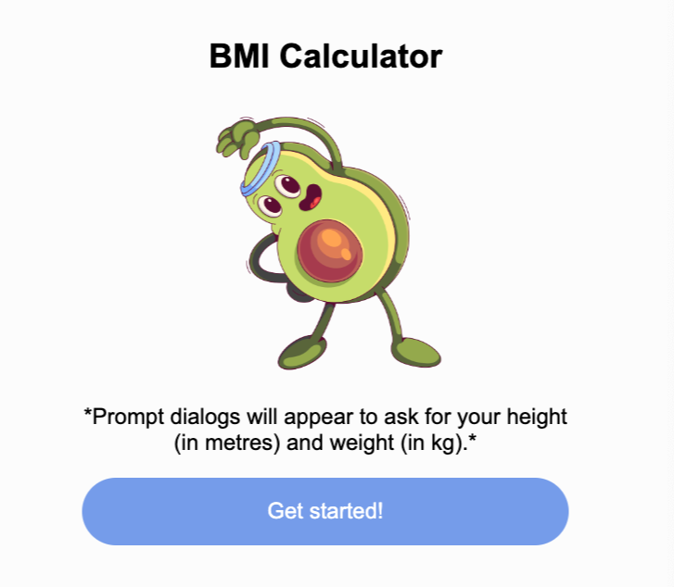
Button not working
Since we have the logic of BMI working, how do we then make it where:
When click on button, it will show the prompt dialogs and alert dialogs?
We have to link our BMI to the button using function!

Slide 55
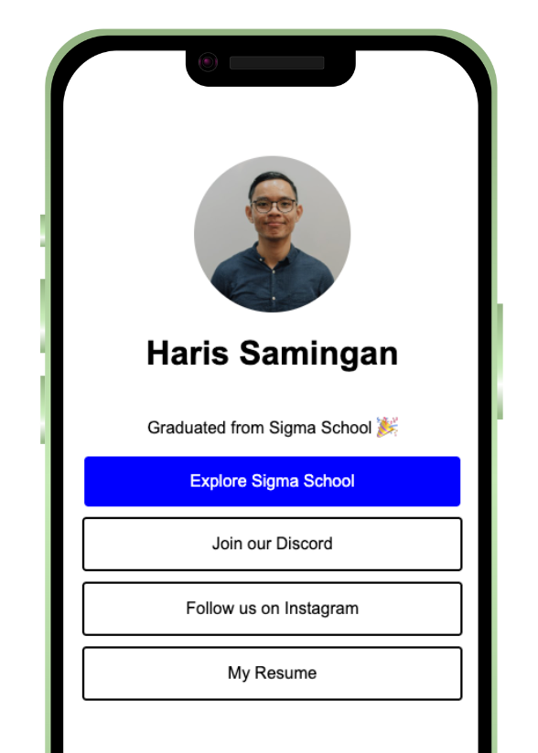
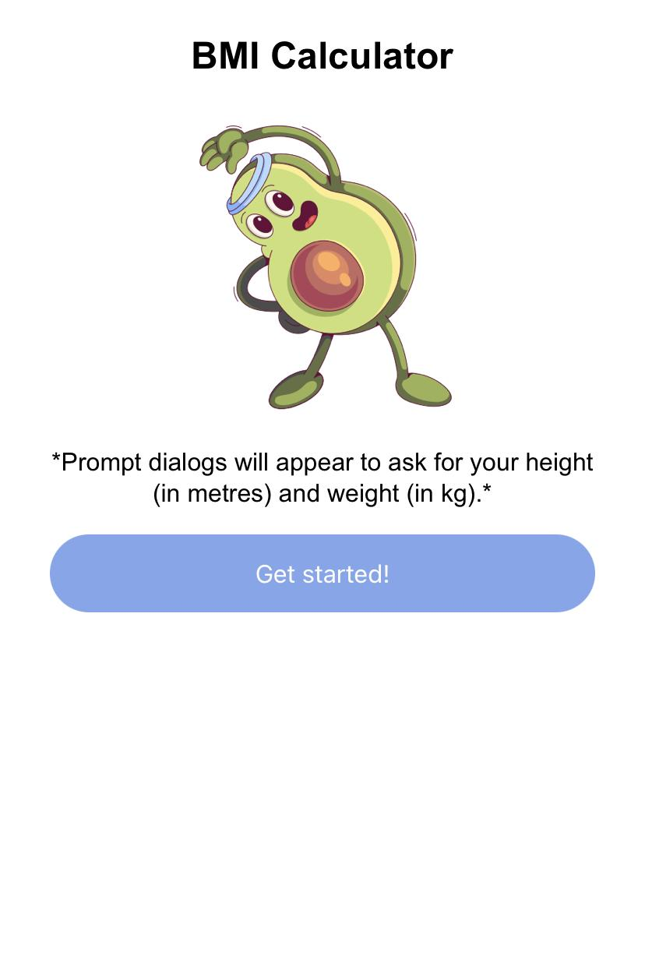

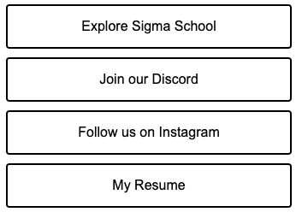
Connect Button with Function

Slide 56
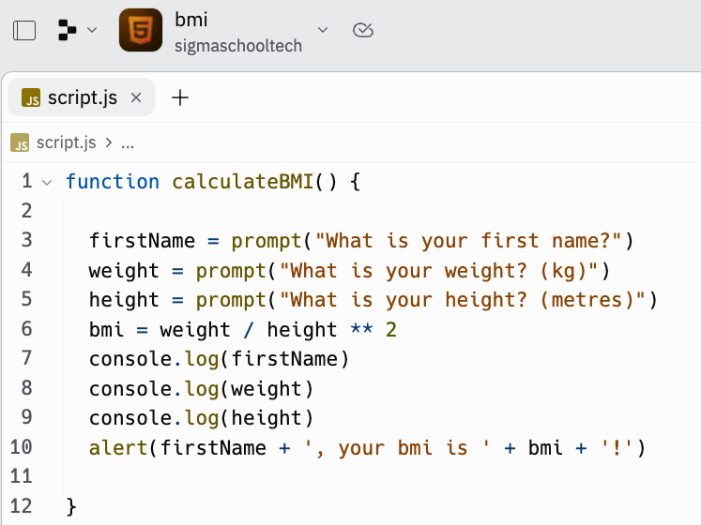
Update the code and run it!

Slide 57
Our code is not working now?
Nope. What we did was to place it in a function.
Can you have cookies with just buying a recipe?
No!
You need to do the work of following the recipe to bake cookies.
Similarly, to do the work, we need to run the function.

Slide 58
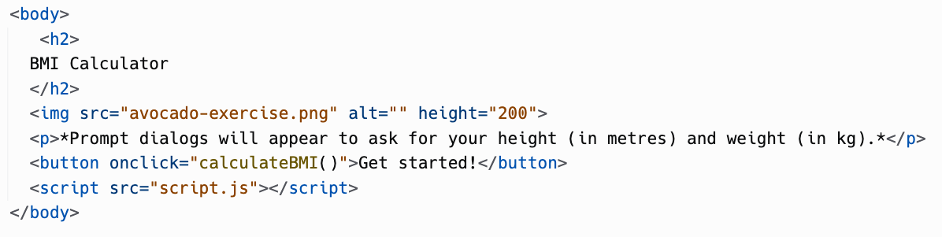
Go to index.html, update the code and run it!
Don’t delete code outside this CodePart. Find this block of code and add the code in the red box. Watch video here if unclear

Slide 59
Go to the webview and click on the button.

Slide 60
Dialogs should appear. Let’s explore what happened!

Slide 61
Creating functions
function reserved keyword
function name
brackets
Curly brackets to enclose function
Function body

Slide 62
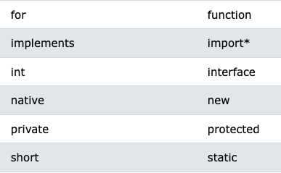
Reserved keywords
In JavaScript, reserved keywords are words that are used by the language and cannot be used as variable or function names.
Reserved words including:
function, if, else, return.

Slide 63
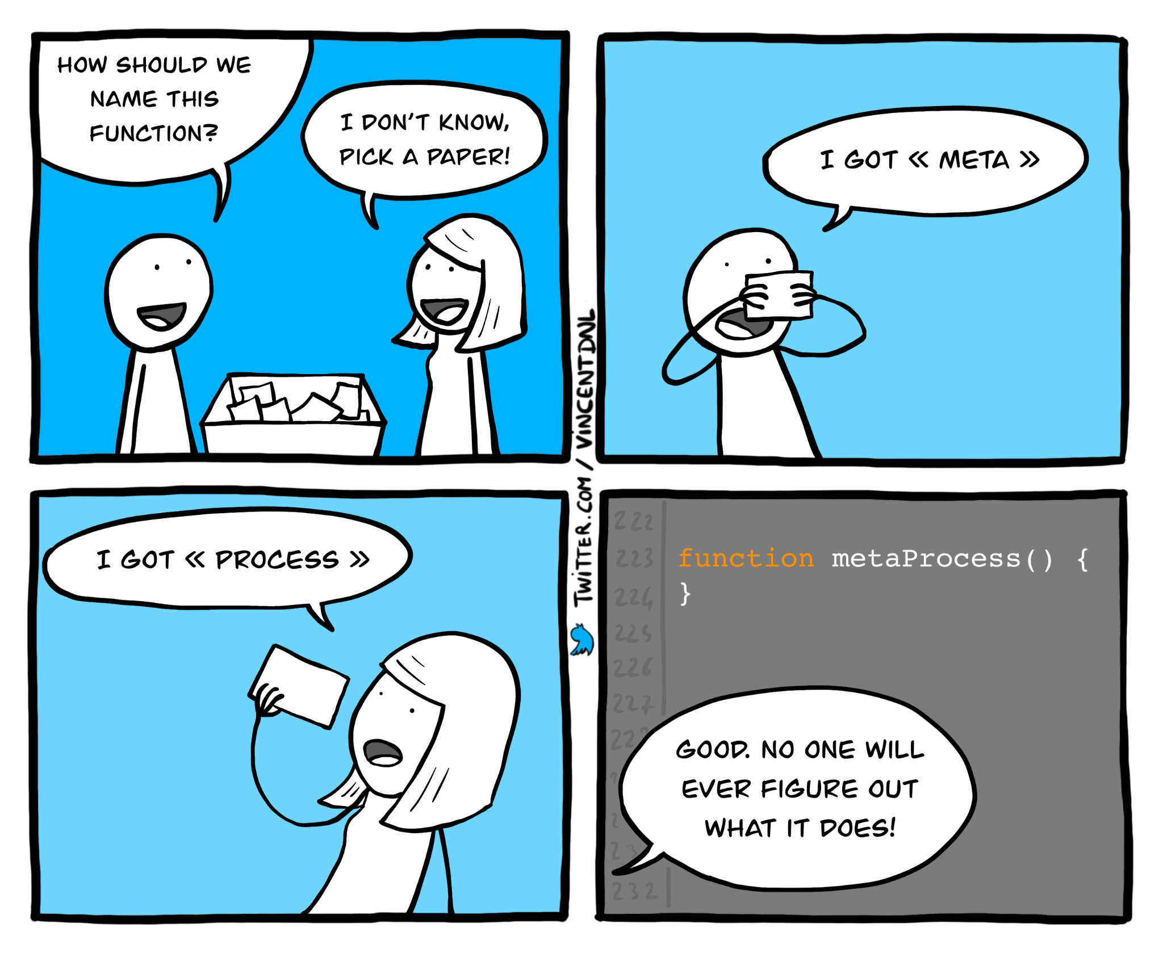
Function name
Like recipes, you can name them anything.
Anything that is readable. Here is an example if you want to name a function to calculate compound interest:
❌ Bad names: cCI, calcComInt
✅ Good name: calculateCompoundInterest
Developers also have a hard time naming stuff. Professional developers appreciate naming that is easy to understand.

Slide 64
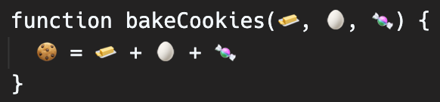
Parameters
It is like ingredients in a recipe. Example:
Bake cookies (ingredients: 🧈, 🥚, 🍬):
🍪 = 🧈 + 🥚 + 🍬
Right now, we don’t need any ingredients or parameters in our function.

Slide 65
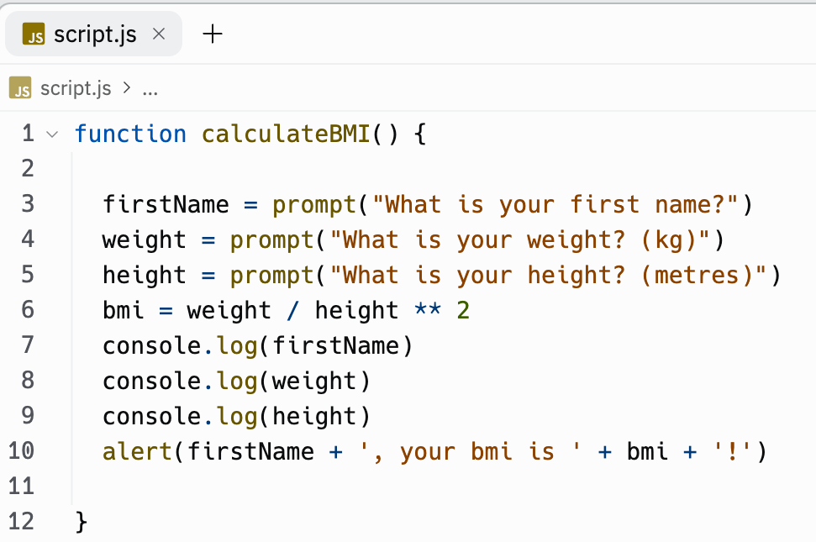
Calling a function
To connect the function in script.js to html, you need
To have script src attribute to be script.js
To run the calculateBMI() function in the onclick attribute

Slide 66

Congratulations!
You have created a BMI application!
Share it in our Discord channel here.
More specifically under the Share Your Achievements section > #i-built-this channel.

Slide 67

Good work. Now, gain points!
Now that you have completed this module, you can gain points by doing this survey:
https://forms.gle/FJzRxgVw7fS2DMPY9
You can gain up to 16 points!
Currently, you can get a free Sigma T-shirt for 150 points.
There will be more freebies in the future ~
Not real. Picture is for illustration purposes.

Slide 68
Full code here:
https://replit.com/@sigmaschooltech/bmi

Slide 69
Day 3 completed!

